Slide 1
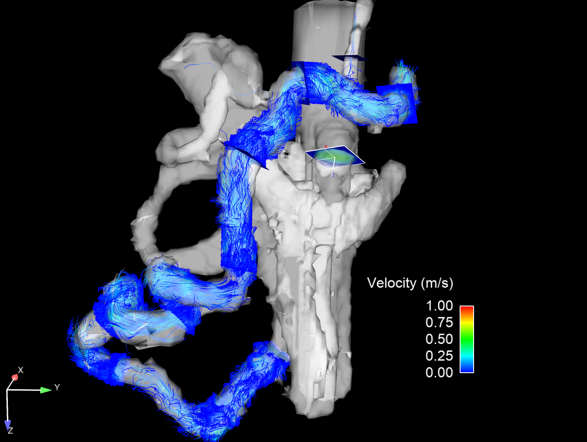
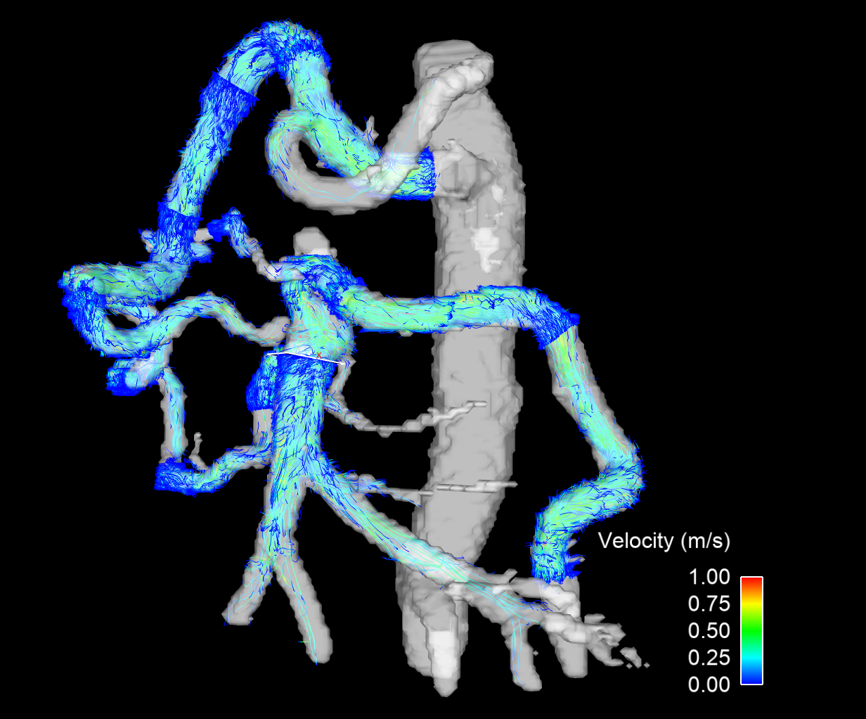
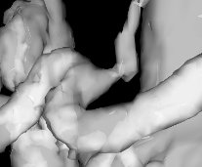
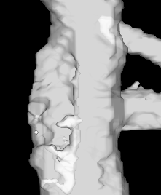
Left gastric artery
GDA
GDA
CA compression
Aortic narrowing
Splenic artery
Pancreaticoduodenal arcades
SMA occlusion
SMA
Arc of Riolan
Distal SMA
IMA

